Slide 1
SOUL MANCER
Karon Minor, Joel Noriega Nieves, Liberty Hanzer
Game Programming Final
Advisor: Dr. Kam Kong

Slide 2
INTRODUCTION
Traditional Turn-Based 2D pixel RPG adventures can be boring and feel passive.
More dynamic, Real-time combat systems offer skill-growth opportunities.
SoulMancer is a hybrid RPG/Fighting Game where you travel through lands and fight enemies.

Slide 3
CAPTURE SOULS TO FIGHT!
Set in a vibrant, pixel art world where slimes, knights, and demons exist, you play as the titular Soul Mancer—the soul of a lost wizard capable of capturing and utilizing the souls of defeated enemies.

Slide 4
Roles
Liberty
BG Music and Sound Effects
Joel
Level Design and Scripting
Karon
Gameplay, Character Art/Animation, UI

Slide 5
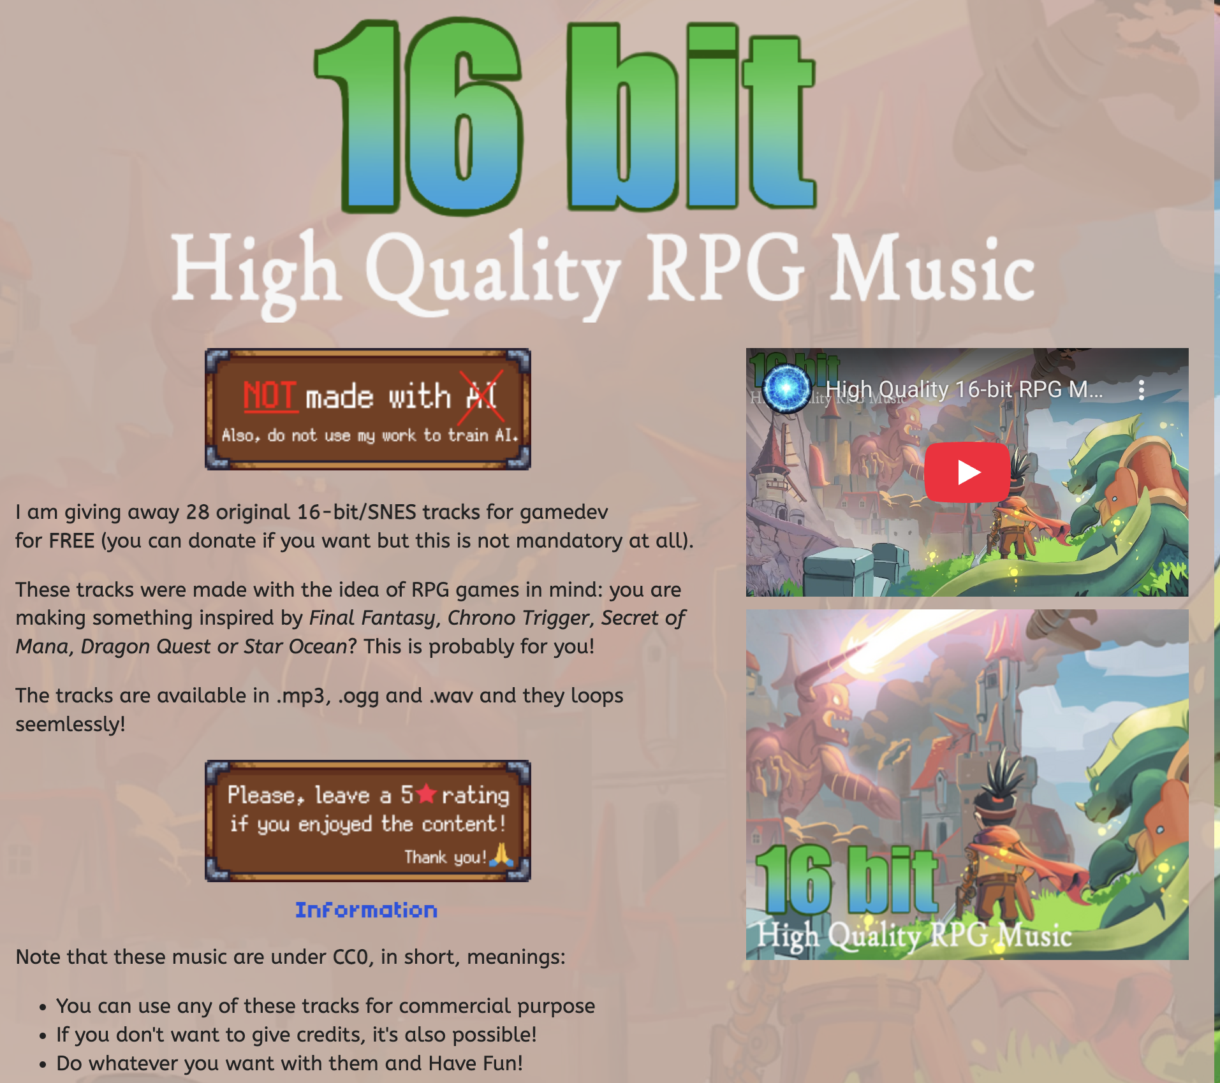
MUSIC
SFX
For music we decided to use free resources found online themed for RPG games. Themes for overworld and battle were set to the scenes.
Sound effects for menu navigation were added and binded to keys on scenes where needed.

Slide 6
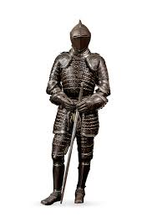
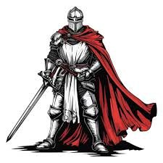
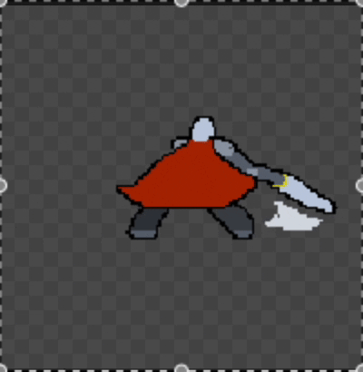
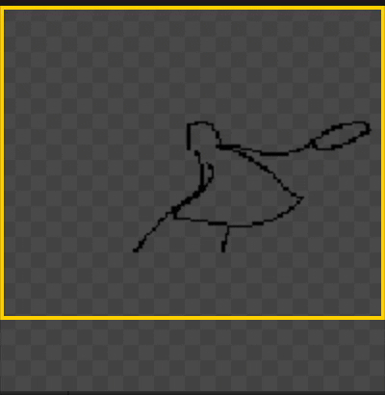
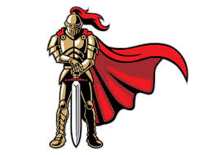
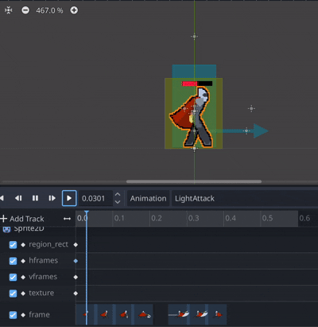
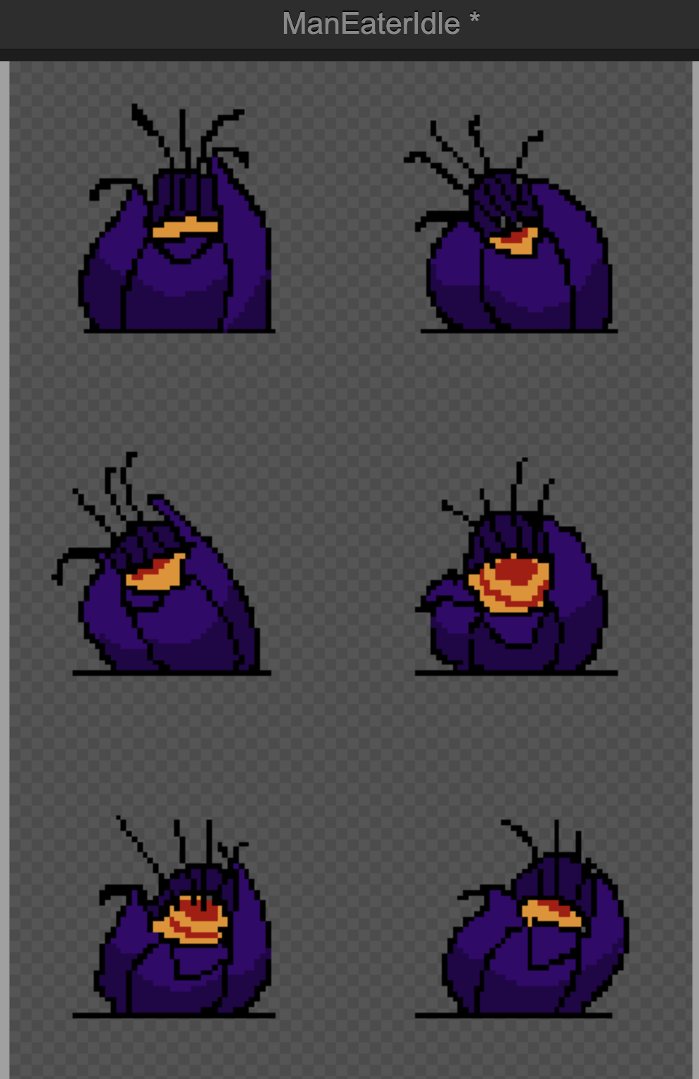
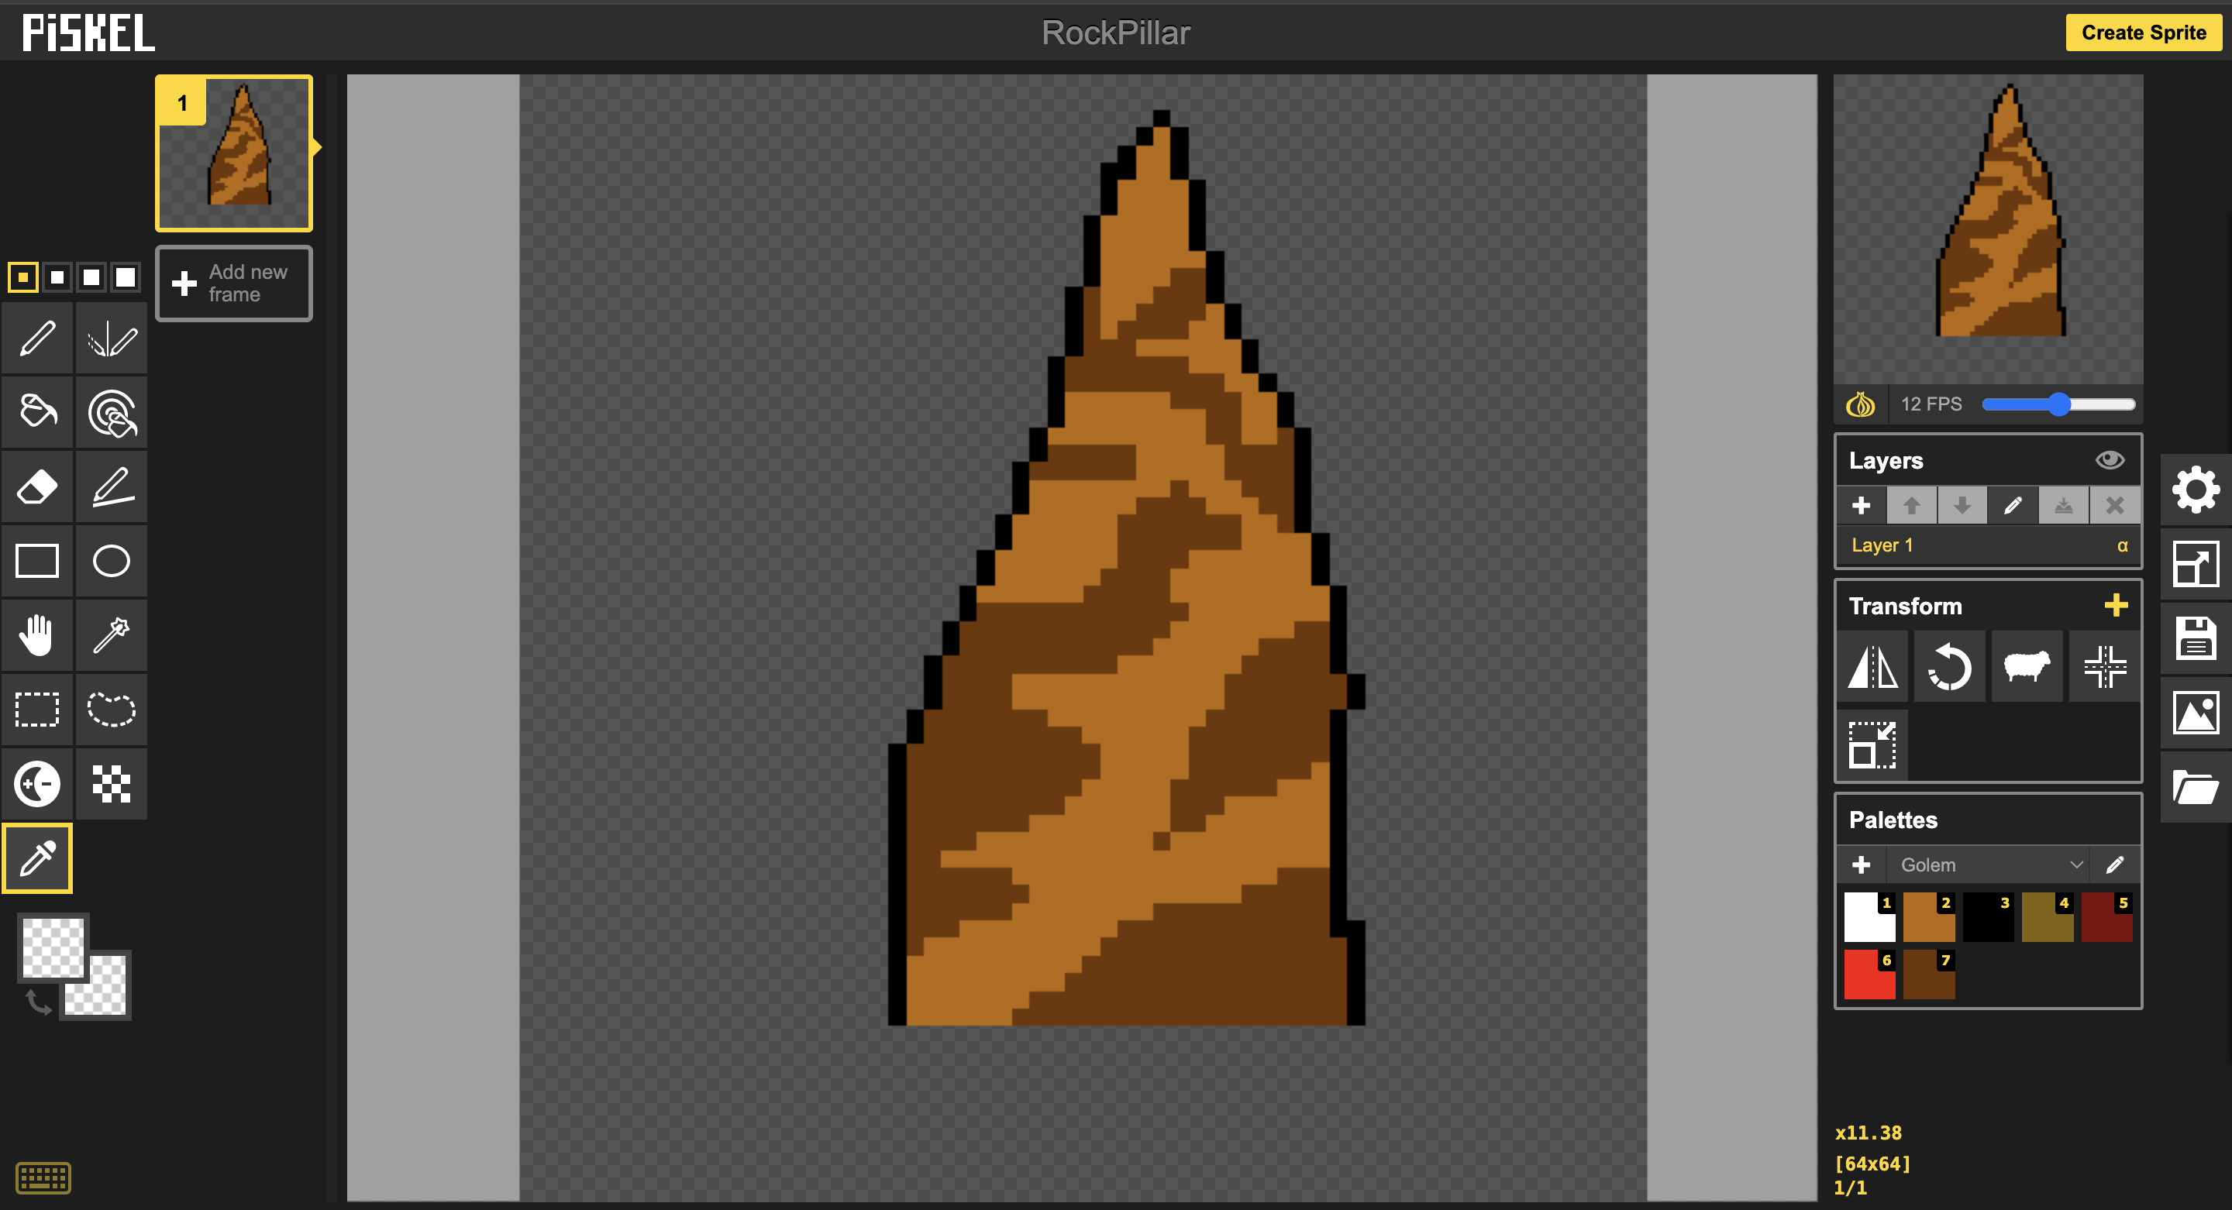
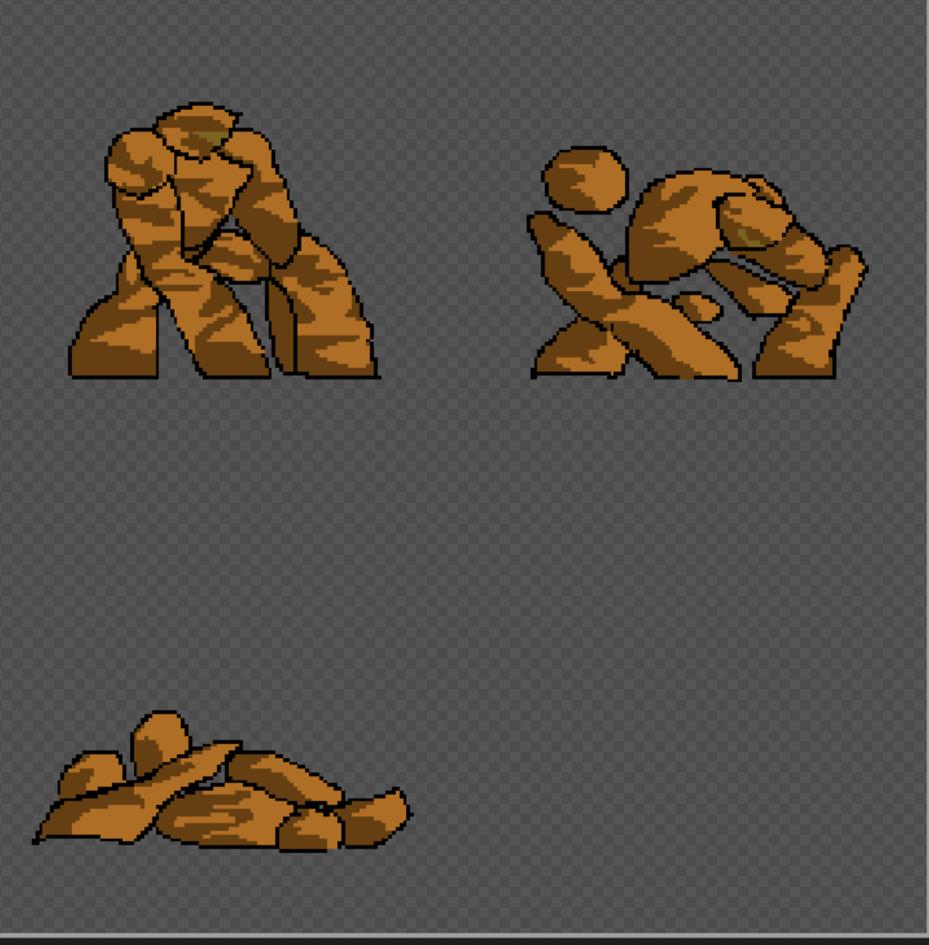
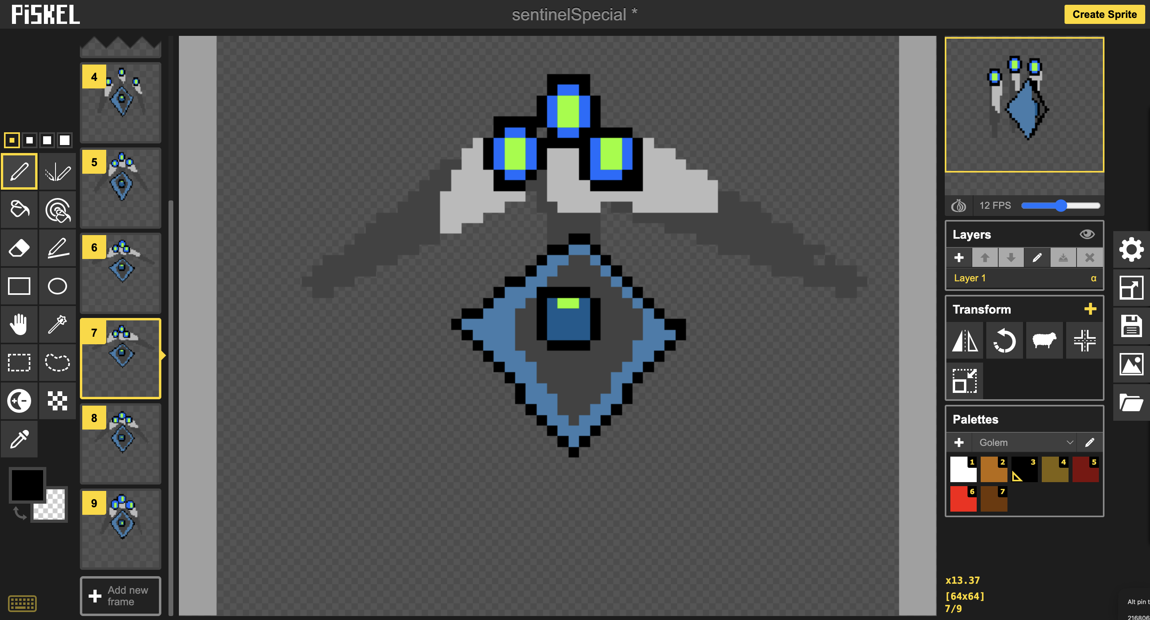
Character Art/Animations
Start with Ideas and planning
To sketching/scaffolding using stickman method
To Coloring, Polishing, and Integrating into the game
Add Hitboxes, Shaders, effects, etc

Slide 7
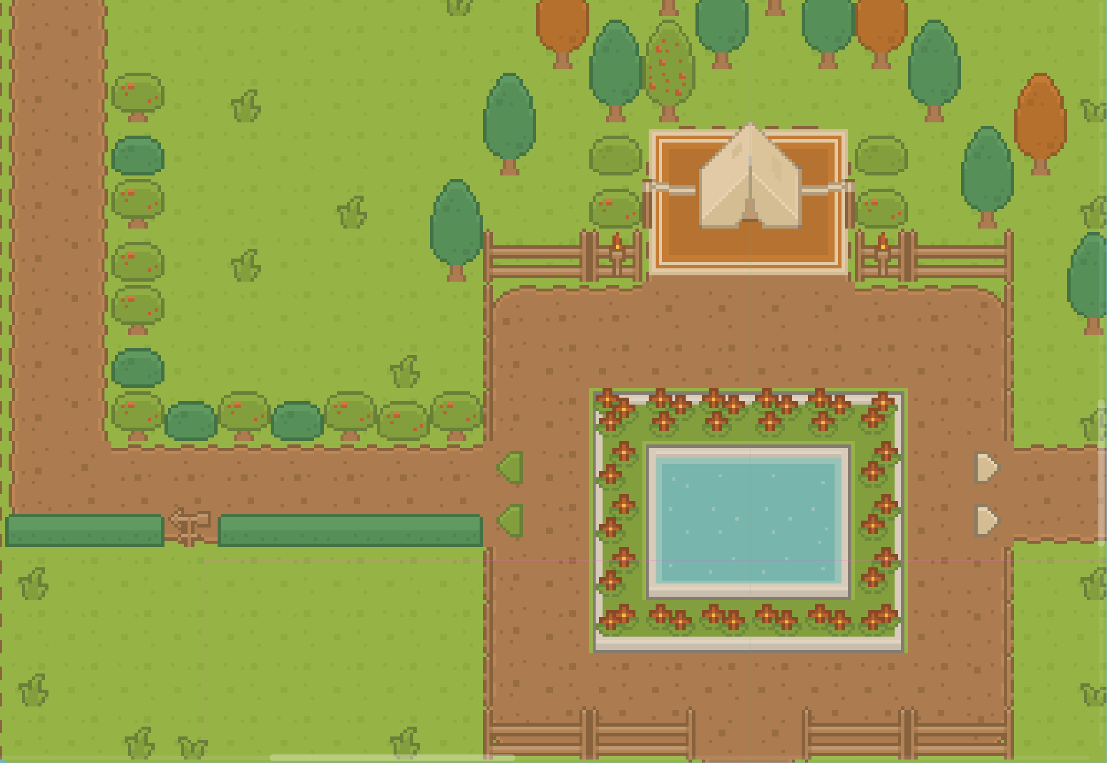
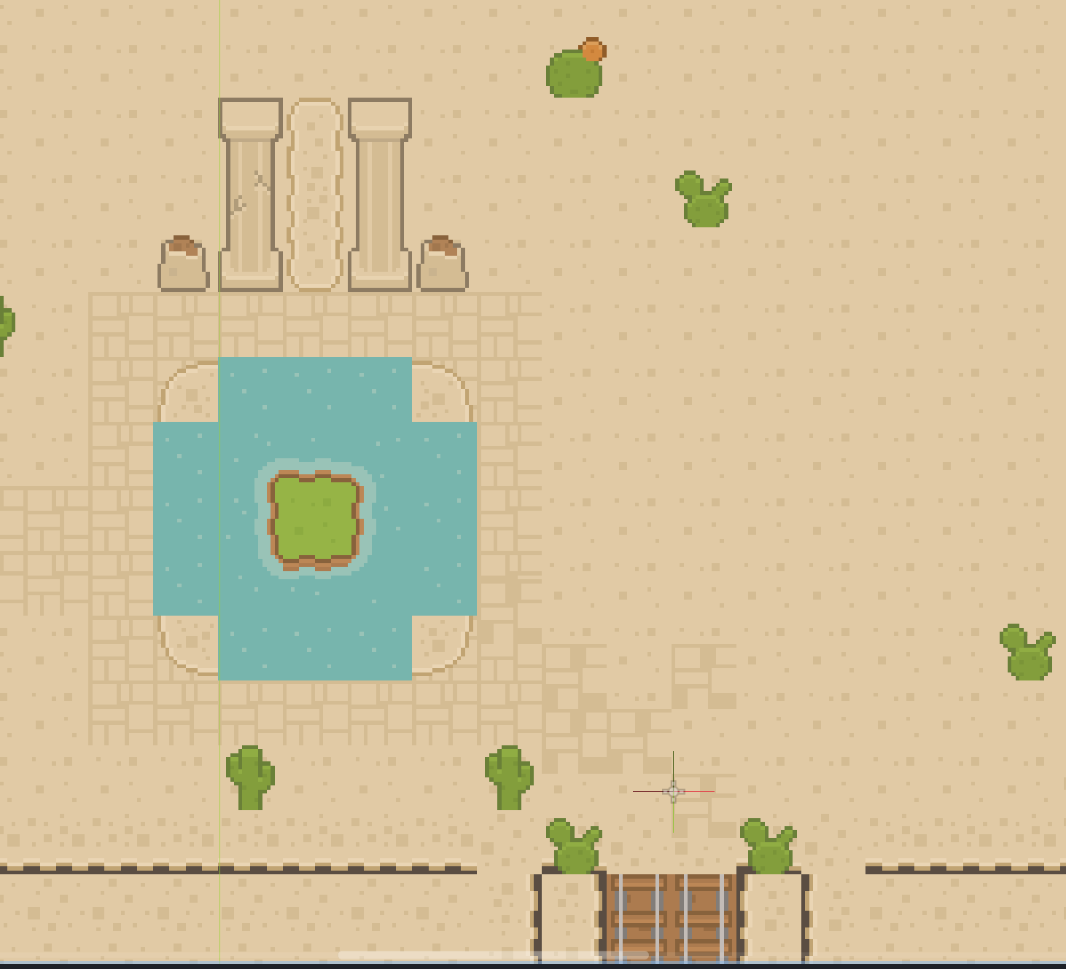
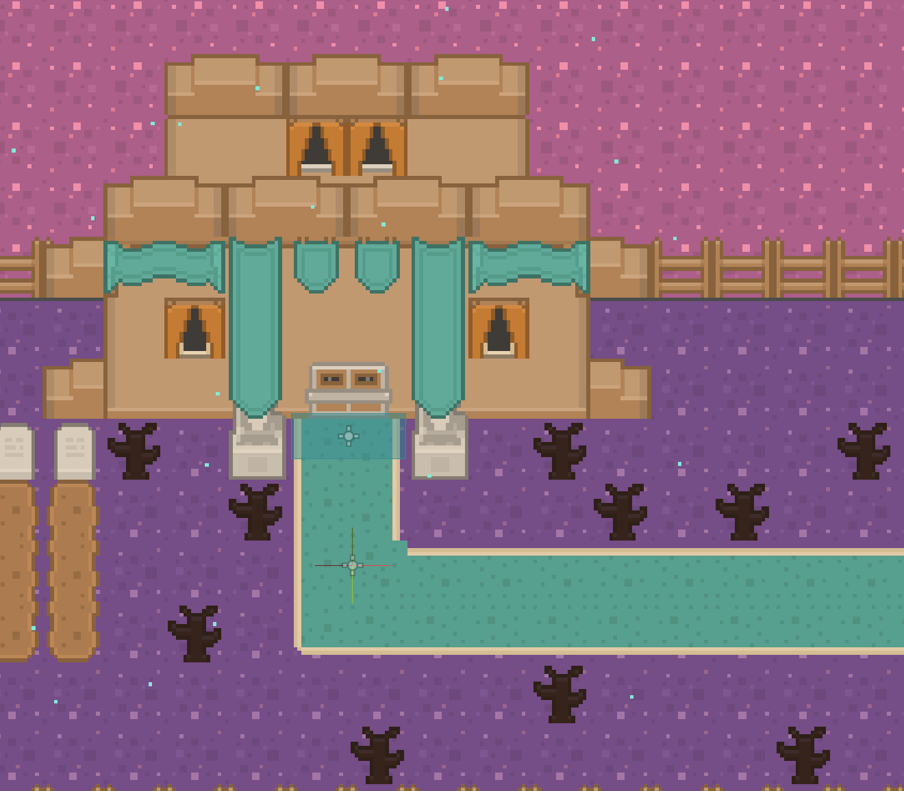
Overworld and Design
Visualize progression
Immerse players
Provide objectives

Slide 8
Gameplay Demo

Slide 9
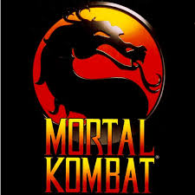

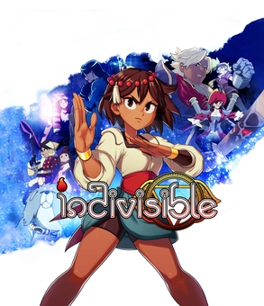


Inspiration and Ideation
Games:
Ideas:
Gameplay and Mechanics of a fighting game
RPG progression system: leveling, party system
Character Art/Animations, Desire to learn pixel art

Slide 10
Future Improvements
Capture System
Chance-based to obtain more characters, managing the party through swapping.
Round Based Moves
Make cooldowns for moves for another level of strategy
Inventory, Items, and Shop
Change up battle strategies depending on items and implement overworld rewards

Slide 11
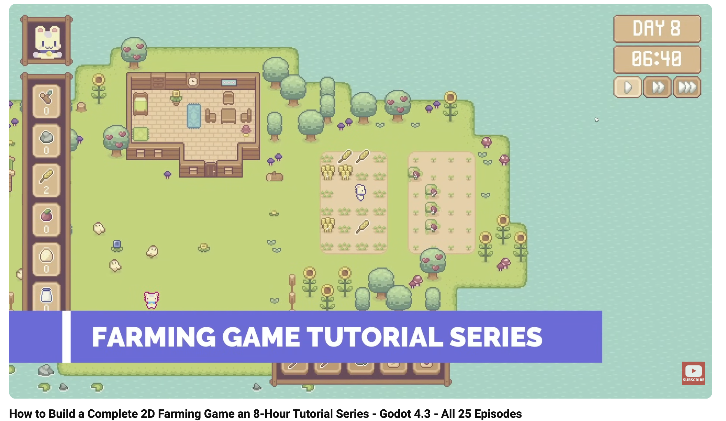
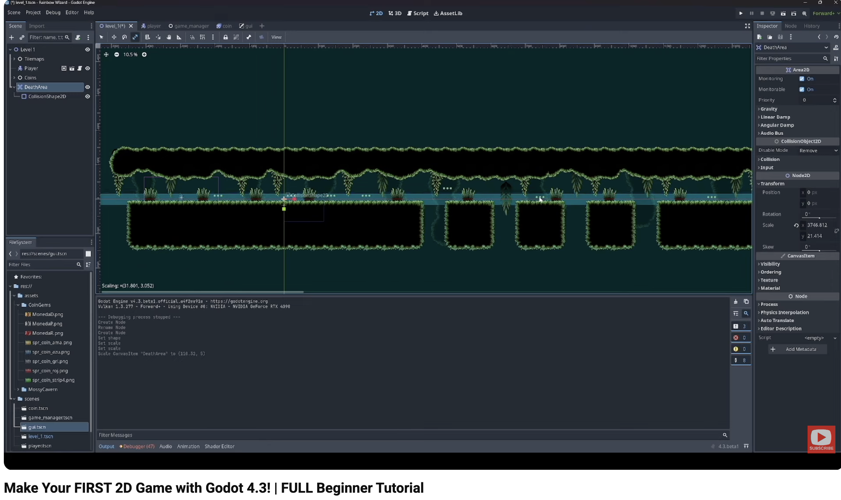
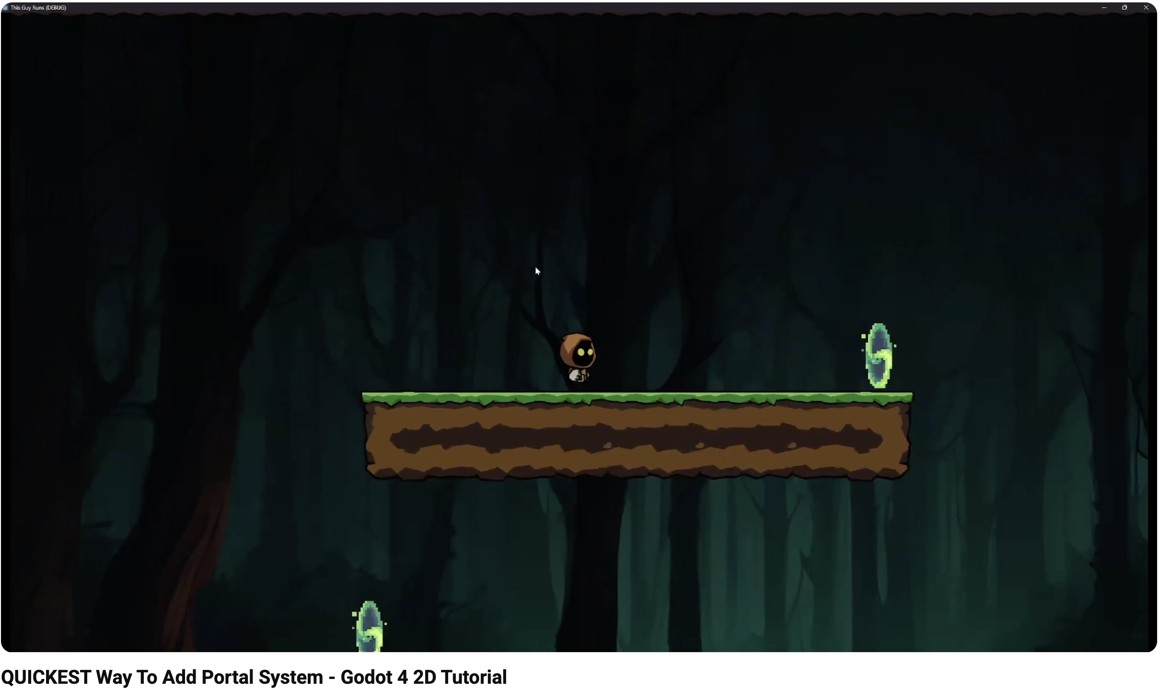
Tutorials
First Tutorial
Second Tutorial
Specific feature
The purpose of this tutorial was to introduce basic Godot functionalities. Tiling, GUI, Player Movement
Introduced different features such as Cameras, Effects, and Level Design
Introduced warping between two places

Slide 12
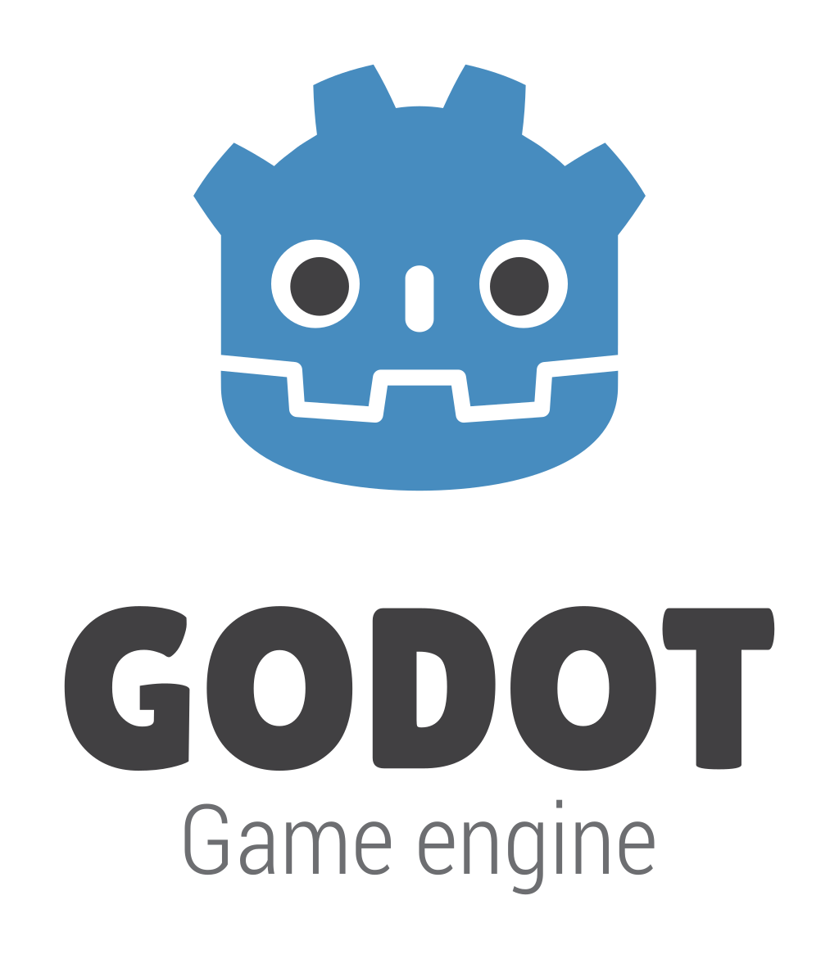
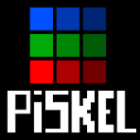

Tools/Assets Used
Piskel
GODOT
Open source game engine
Website For Pixel Art/Animation creation
Itch.io
Assets for UI, Effects, and Map tiles

Slide 13
Thank You!!!
Any questions?
A

